Slide 1
DDSAnalytics Attrition Rates
An Exploratory Data Analysis
Data Team
Alec Lepe & Che’ Cobb
November 28, 2018

Slide 2


Agenda with EDA
Understand the Data Structure
Leading Factors for Employee Attrition
Identify the trends and variables
Build a predictive model
Project Github repository:
  https://github.com/lepealec/MSDS-6306-Second-Case-Study

Slide 3
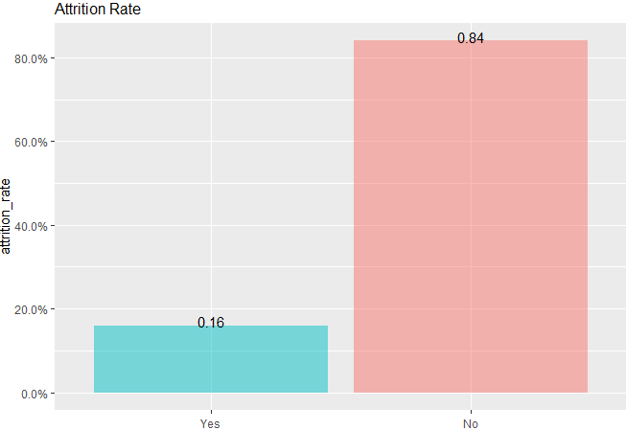
Data Analysis and Cleaning
There are 35 separate variables, including attrition
Attrition Count is about 16%
Eliminated Non relevant data with little information:
"EmployeeCount“ “Over18” “StandardHours

Slide 4
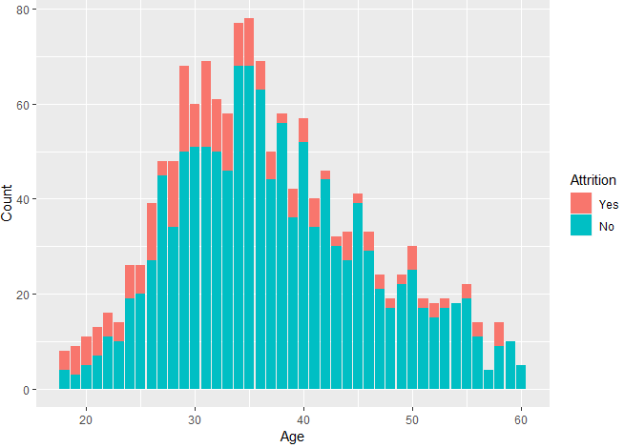
Most Popular ages(28-35)

Slide 5
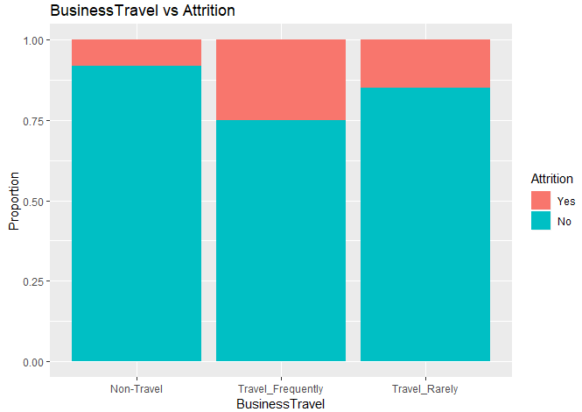
People who travel are more than likely to have more attrition

Slide 6
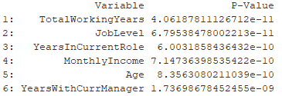
Automatically detecting good single predictors
Top Predictors by p-value

Slide 7
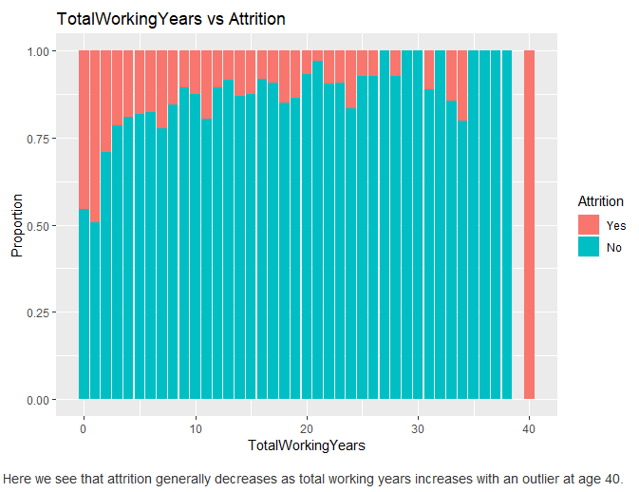
TotalWorkingYears

Slide 8
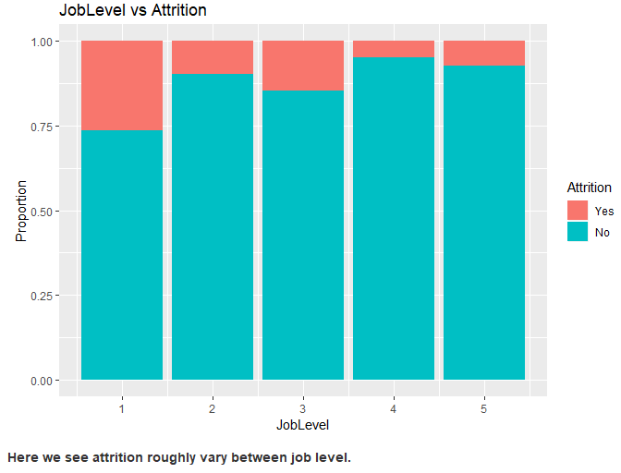
JobLevel

Slide 9
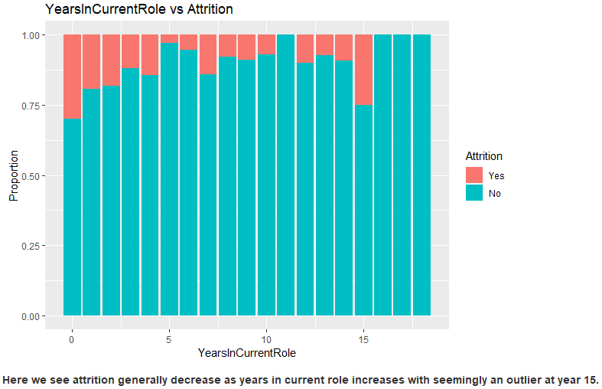
YearsInCurrentRole

Slide 10
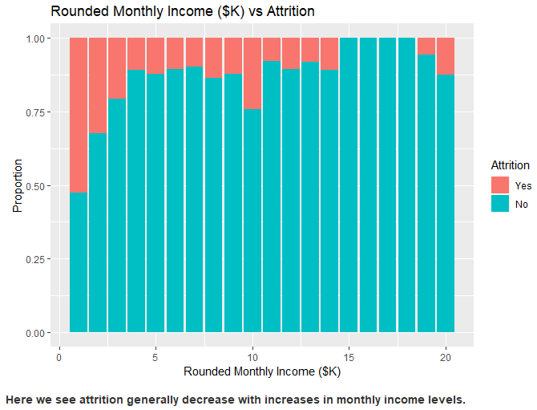
MonthlyIncome

Slide 11
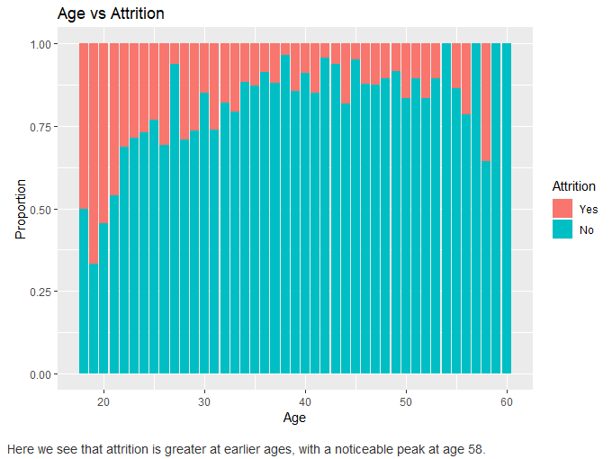
Age

Slide 12
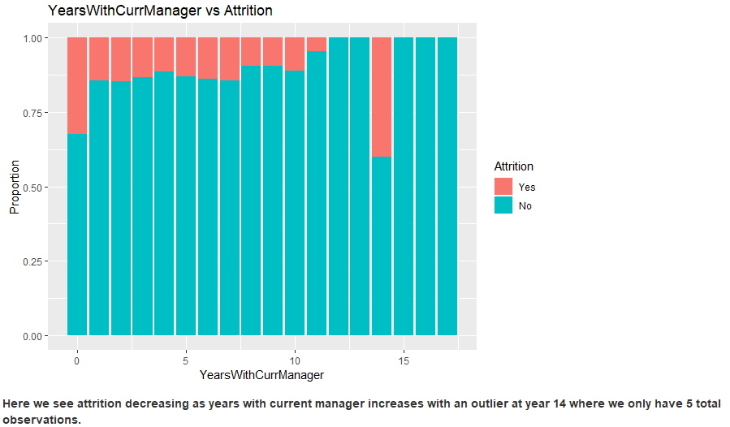
YearsWithCurrentManager

Slide 13
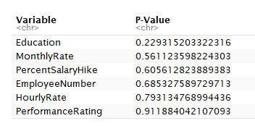
Worse Predictors
Top 6

Slide 14
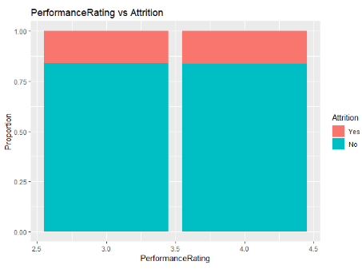
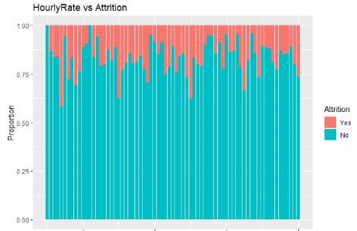
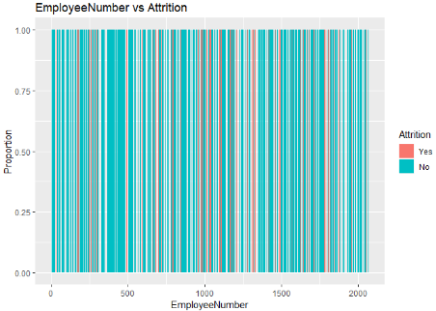
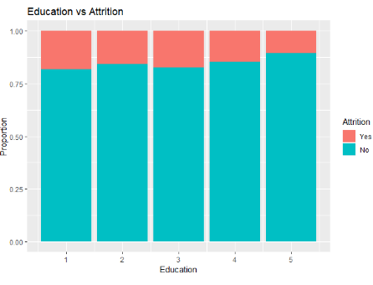
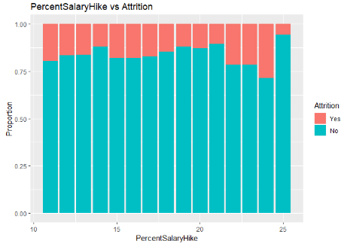
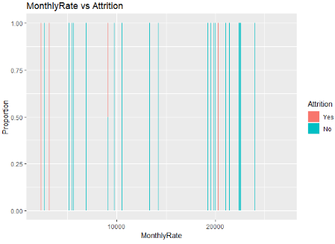
Graphs of Worst Predictors

Slide 15
Machine Learning
Create testing and training data set from original data.
  Randomly select 70% of the data for training.
  Other 30% is designated for testing data set.

Slide 16
Machine Learning - Full Model
Using a full model (all variables), here are the top indicators that lead to attrition:
Overtime (Yes)
EnvironmentSatisfaction
NumCompaniesWorked
BussinessTravel (Travel Frequently)
All indicators have p value less than 0.0001

Slide 17
Machine Learning - Partial Model
Using a partial model (variables that have p values < 0.05), here are the top indicators that lead to attrition:
OverTime (Yes)
EnvironmentSatisfaction
NumCompaniesWorked

Slide 18
Machine Learning - Forward Selection Methodology
Start with an empty model and systematically add variables.
Select variables that increase total accuracy on the training dataset
Do not select variables that do not increase total accuracy.

Slide 19
Machine Learning - Forward Selection
Using a forward variable selection method, with total accuracy in mind, here are the top 3 indicators:
OverTime (Yes)
YearsSinceLastPromotion
YearsInCurrentRole
All indicators have p value less than 0.0001

Slide 20
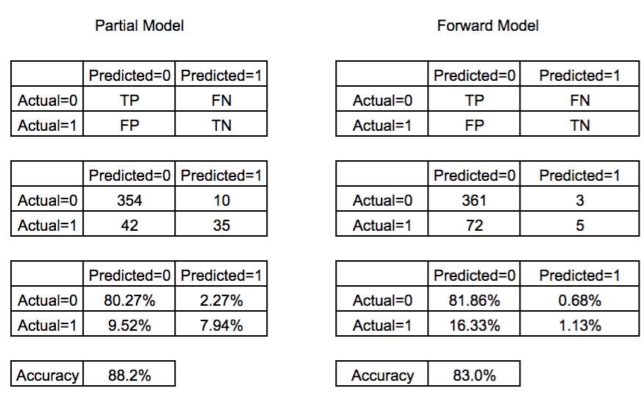
Machine Learning - Partial Model Evaluation
Running the fitted model on the training set here are the confusion matrices for the two models
The partial model has an overall greater accuracy than the two.
The forward model generated less negatives in general which does not make it totally worse than the partial model.

Slide 21
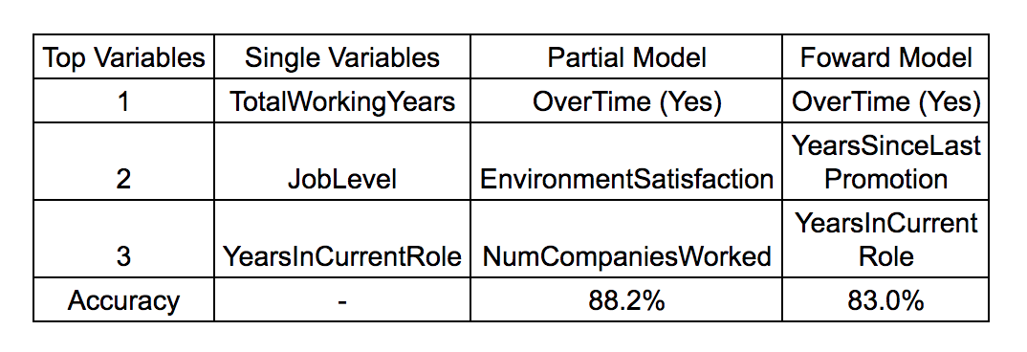
Conclusion & Model Comparison
Based on the partial model that obtained a higher accuracy, overtime, environmental satisfaction, and number of companies worked are the top 3 indicators that lead to attrition.

